Slide 1

Sequence motif finding: Gibbs sampling
Hugh Patterton
Center for Bioinformatics and Computational Biology
Stellenbosch University
South Africa
sun.ac.za/sci-bioinformatics

Slide 2
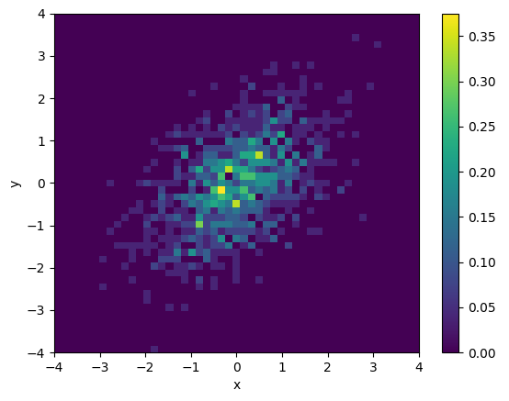
Sampling a 2-dimensional probability distribution
A 2-dimensional plot is shown left:
X: -4 ≤ x ≤ 4, and
Y: -4 ≤ y ≤ 4
We are interested in sampling this distribution, i.e., choose a specific point based on the probability associated with that point. The key from purple to yellow indicates the probabilities associated with each datum point
Note that the probabilities are not symmetrical. The plot is wider bottom-left to top-right than it is top-left to bottom-right.
It is very difficult to reliably sample from a 2-dimensional probability distribution
One trick is to keep Y constant and sample X, and then to keep that sampled X constant and sample Y
This is shown by the red line connecting the various points
This approach tends to sample with higher frequency in the region of the 2-dimensional distribution where the probability is highest
This is the basis of Gibbs sampling
p(x|y) and p (y|x)

Slide 3
Gibbs sampling for motifs – a rough description
sequence 0 CTAAGGGCGTGGGGACTAATCAGCAATTAGGCTTAACCTAGTCGGATCCT
sequence 1 GGAGGATCCTGCCATTCAATGGTCGTTATTAAAGAAAACTGGATGCCCGG
sequence 2 TTTGCGTGATCGAGCCACTATCTTCAATAGGTAATTCGAGGATCCGCCGA
sequence 3 CTGCAGCAGGCGAGCGAGCGTCCTTGGGGCCCAGAAAGGGATCCTCGGGG
sequence 4 GGTCCTTCTCGTCAGTCGCCGAGGATCCTAGCCCAGCCACGGTGCTGCGA
sequence 5 TCTAGCAGGCGGATCCGAGGGTGCCAGTGGCCCTTCCATTCCACGCTAAA
Randomly chosen sequence
Assume that the motif that we are searching for is 6 bp wide (W = 6)
Randomly remove one of the sequences 0-5
For the remaining 5 sequences, randomly choose a 6 bp substring (boxes above)
Calculate the score of this substring as a matrix (see next slide)
Calculate the match of this matrix to every position in the removed sequence
Sample the removed sequence in terms of the probability of the match at each position
Add the sampled site sequence to the list of site sequences
If the new site sequence list scores better, retain it
Randomly choose a new substring in the group of 5 sequences
Assign the identified substring in the removed sequence at the chosen substring, and add the removed sequence back with the other 5 sequences
Randomly choose another sequence to remove, and repeat from step 3
Continue for a set number of iterations of until convergence
Output the site sequence list

Slide 4
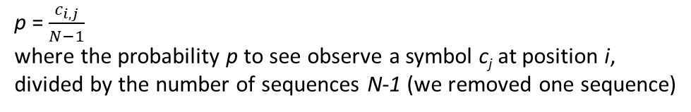
Gibbs frequency matrix
Symbol | c_{ij}
Symbol | Position
 | 0 | 1 | 2 | 3 | 4 | 5
G | 4 | 1 | 1 | 2 | 2 | 1
A | 1 | 0 | 1 | 1 | 1 | 1
T | 0 | 1 | 0 | 1 | 1 | 2
C | 0 | 3 | 3 | 1 | 1 | 1
GCGTGG
GTCGTT
GCAGCA
AGCCAC
GCCAGT
p = $\frac{c_{i,j}}{N−1}$
where the probability p to see observe a symbol c_{j} at position i,
divided by the number of sequences N-1 (we removed one sequence)
Normalise to the sum of each column to get frequency
Symbol | Frequency
Symbol | Position
 | 0 | 1 | 2 | 3 | 4 | 5
G | 0.8 | 0.2 | 0.2 | 0.4 | 0.4 | 0.2
A | 0.2 | 0 | 0.2 | 0.2 | 0.2 | 0.2
T | 0 | 0.2 | 0 | 0.2 | 0.2 | 0.4
C | 0 | 0.6 | 0.6 | 0.2 | 0.2 | 0.2
Weak consensus GCCGNT

Slide 5
Background correction
What is the chance that the defined “consensus sequence” will be found randomly in the background sequence?
We must normalize for the background
Use only background sequences that are not part of the randomly selected substrings
sequence 0 CTAAGGGCGTGGGGACTAATCAGCAATTAGGCTTAACCTAGTCGGATCCT
sequence 1 GGAGGATCCTGCCATTCAATGGTCGTTATTAAAGAAAACTGGATGCCCGG
sequence 2 TTTGCGTGATCGAGCCACTATCTTCAATAGGTAATTCGAGGATCCGCCGA
sequence 3 CTGCAGCAGGCGAGCGAGCGTCCTTGGGGCCCAGAAAGGGATCCTCGGGG
sequence 4 GGTCCTTCTCGTCAGTCGCCGAGGATCCTAGCCCAGCCACGGTGCTGCGA
sequence 5 TCTAGCAGGCGGATCCGAGGGTGCCAGTGGCCCTTCCATTCCACGCTAAA
Randomly chosen sequence
Symbol | Count
Symbol | Sequence
 | 0 | 1 | 2 | 3 | 4 | 5 | Σ
G | 10 | 12 |  | 19 | 14 | 12 | 67
A | 13 | 14 |  | 7 | 5 | 9 | 48
T | 11 | 9 |  | 6 | 10 | 9 | 45
C | 10 | 9 |  | 12 | 15 | 14 | 60
 |  |  |  |  |  | Total | 220
Normalize the sum of each symbol to the total number of symbols
Symbol | Frequency
Symbol
G | 0.3045
A | 0.2182
T | 0.2045
C | 0.2727

Slide 6
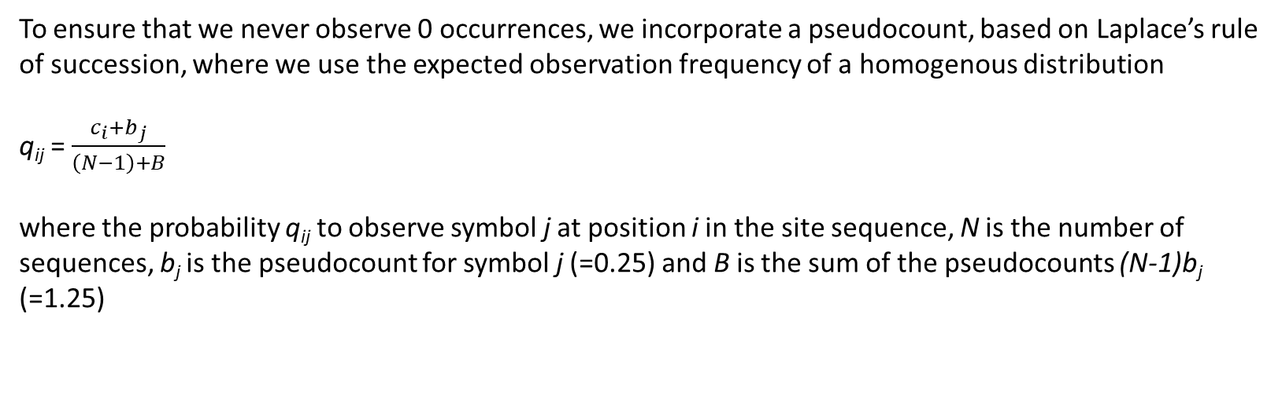
Incorporate pseudo counts into the frequencies
To ensure that we never observe 0 occurrences, we incorporate a pseudocount, based on Laplace’s rule of succession, where we use the expected observation frequency of a homogenous distribution
q_{ij} = $\frac{c_{i}{+b}_{j}}{\left(N−1\right)+B}$
where the probability q_{ij} to observe symbol j at position i in the site sequence, N is the number of sequences, b_{j} is the pseudocount for symbol j (=0.25) and B is the sum of the pseudocounts (N-1)b_{j} (=1.25)
Symbol | q_{ij}
Symbol | Position
 | 0 | 1 | 2 | 3 | 4 | 5
G | 4.04 | 1.04 | 1.04 | 2.04 | 1.04 | 1.04
A | 1.04 | 0.04 | 1.04 | 1.04 | 1.04 | 1.04
T | 0.04 | 1.04 | 0.04 | 1.04 | 1.04 | 2.04
C | 0.04 | 3.04 | 3.04 | 1.04 | 1.04 | 1.04

Slide 7
Calculating the q-matrix
def calculate_q_matrix(site_sequences,pseudocount,symbol_alphabet): number_of_sequences = len(site_sequences) number_of_symbols = len(symbol_alphabet) site_width = len(site_sequences[0]) count_matrix = [] count_row = [0]*site_width for i in range(number_of_symbols): count_matrix.append(count_row.copy()) q_matrix = copy.deepcopy(count_matrix) # calculate count matrix for position in range(site_width): for symbol_index in range(number_of_symbols): count = 0 for index in range(number_of_sequences): if site_sequences[index][position] == symbol_alphabet[symbol_index]: count += 1 count_matrix[symbol_index][position] = count #use count matrix to calculate q_matrix for position in range(site_width): for symbol_index in range(number_of_symbols): q_matrix[symbol_index][position] = count_matrix[symbol_index][position]+
pseudocount/(number_of_sequences+number_of_sequences*pseudocount) return count_matrix, q_matrix

Slide 8
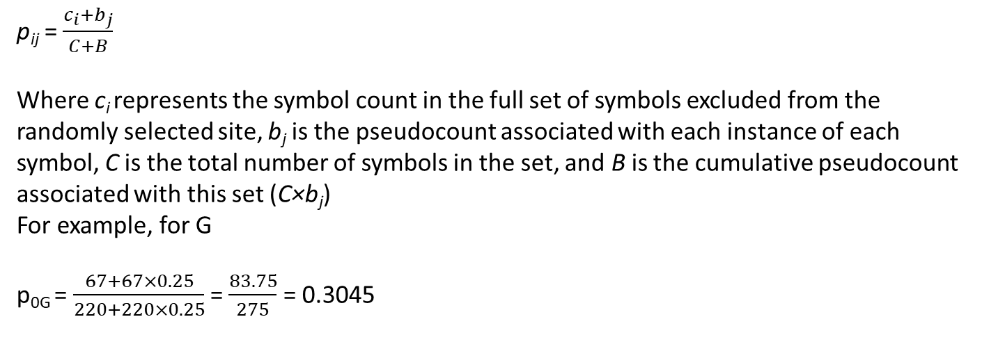
Background using peudo counts
p_{ij} = $\frac{c_{i}{+b}_{j}}{C+B}$
Where c_{i} represents the symbol count in the full set of symbols excluded from the randomly selected site, b_{j} is the pseudocount associated with each instance of each symbol, C is the total number of symbols in the set, and B is the cumulative pseudocount associated with this set (C×b_{j})
For example, for G
p_{0G} = $\frac{67+67×0.25}{220+220×0.25}$ = $\frac{83.75}{275}$ = 0.3045
Symbol | p_{ij}
Symbol
G | 0.3045
A | 0.2182
T | 0.2045
C | 0.2727

Slide 9
Calculating the background-matrix
def calculate_background_matrix(background_sequences,symbol_alphabet): total_length = 0 number_of_symbols = [0]*len(symbol_alphabet) number_of_sequences = len(background_sequences) for i in range(number_of_sequences): total_length += len(background_sequences[i]) for j in range(len(symbol_alphabet)): number_of_symbols[j] += background_sequences[i].count(symbol_alphabet[j]) b_matrix = [] for index in range(len(symbol_alphabet)): b_matrix.append(number_of_symbols[index]/total_length) return b_matrix

Slide 10
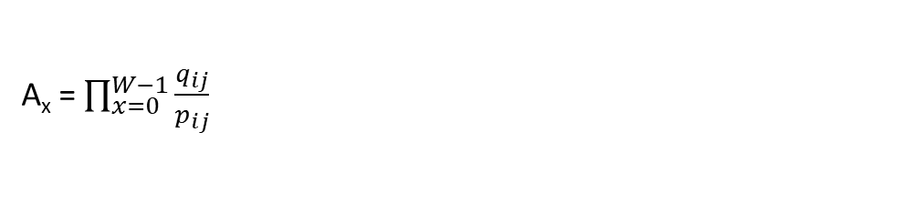
Calculating A_{x}
A_{x} = $\prod_{x=0}^{W−1}{\frac{q_{ij}}{p_{ij}}}$
def calculate_Ax(site_sequence, q_matrix, background_matrix, symbol_alphabet): site_length = len(site_sequence) symbol_indexes = [] for i in range(site_length): symbol_indexes.append(symbol_alphabet.index(site_sequence[i])) numerator = 1 demoninator = 1 for i in range(site_length): numerator *= q_matrix[symbol_indexes[i]][i] demoninator *= background_matrix[symbol_indexes[i]] Ax = numerator/demoninator return Ax

Slide 11
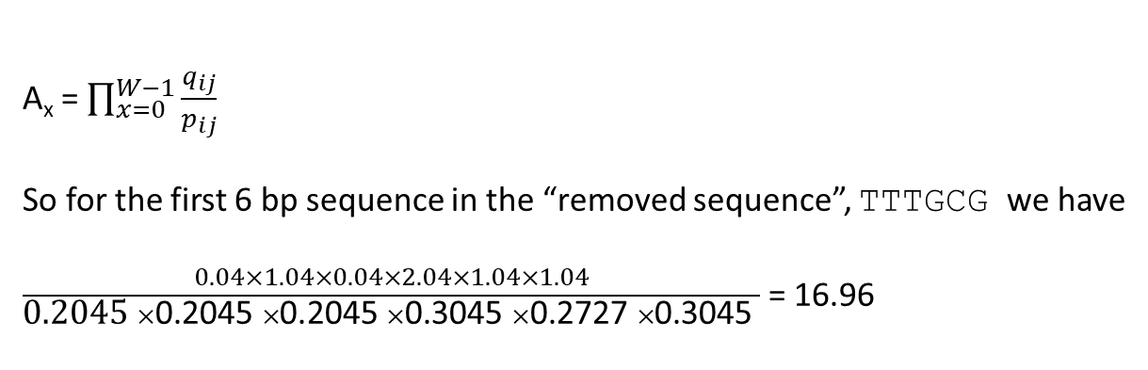
Calculating the probability of a sequence
A_{x} = $\prod_{x=0}^{W−1}{\frac{q_{ij}}{p_{ij}}}$
So for the first 6 bp sequence in the “removed sequence”, TTTGCG we have
$\frac{0.04×1.04×0.04×2.04×1.04×1.04}{\text{0.2045} ×\text{0.2045} ×\text{0.2045} ×\text{0.3045} ×\text{0.2727} ×\text{0.3045} }$ = 16.96

Slide 12
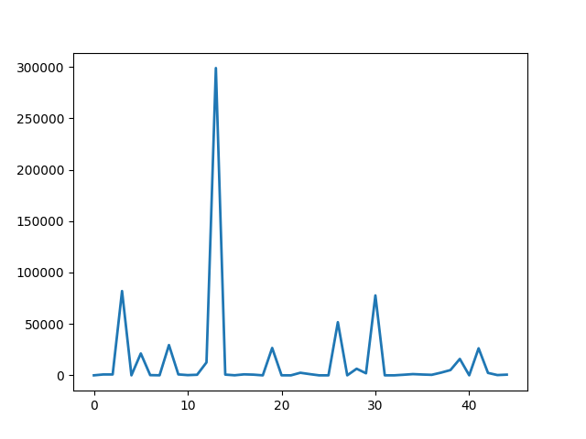
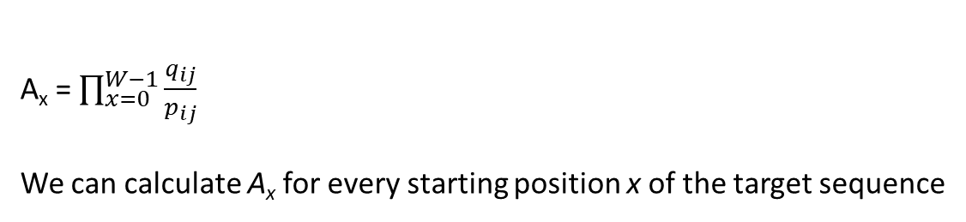
Calculate A_{x} for every site on the removed sequence
A_{x} = $\prod_{x=0}^{W−1}{\frac{q_{ij}}{p_{ij}}}$
We can calculate A_{x} for every starting position x of the target sequence
A₄
A₃
A₂
A_{L-W}
A₁
TTTGCGTGATCGAGCCACTATCTTCAATAGGTAATTCGAGGATCCGCCGA
Note that datum point 13 is very large (A_{x} = 298799)
The sequence here is GCCACT
If you look-up the non-background corrected q_{ij} values for this sequence, you will find that i matches the current “consensus” pretty closely

Slide 13
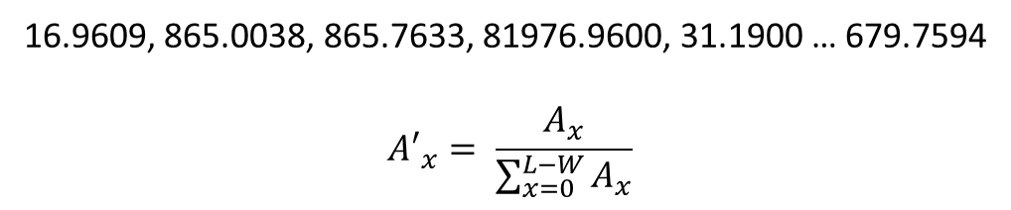
Probability interval
We now convert the series of A_{x} values determined for the removed sequence to probabilistic values by normalizing to the sum of all A_{x} values
16.9609, 865.0038, 865.7633, 81976.9600, 31.1900 … 679.7594
$${A′}_{x}= \frac{A_{x}}{\sum_{x=0}^{L−W}{A_{x}}}$$
def Ax_to_probability_distribution(Ax): number_of_entries = len(Ax) sum = 0 for i in range(number_of_entries): sum += Ax[i] Ax_normalised = [] for i in range(number_of_entries): Ax_normalised.append(Ax[i]/sum) return Ax_normalised

Slide 14
Selecting the consensus site sequence
We now have a site sampled from the probability distribution A’_{x}, that should contain a site that closely matches the q_{ij} matrix of the remaining sequences (one sequence was removed to calculate A_{x})
We add the sequence of this site to that of the sites used to construct the qij matrix
The list of site sequences is now scored against the starting list
The scoring calculates how many of the symbols at each position in the list of site sequences are identical. Thye maximum at each position is subtracted from the number of sequences; is the symbol in all site sequences are the same, the score is 0.
GCGTGG
GTCGTT
GCAGCA
AGCCAC
GCCAGT
GGATCC
Symbol | Position
 | 1 | 2 | 3 | 4 | 5 | 6
G | 5 | 2 | 1 | 2 | 2 | 1
A | 1 |  | 2 | 1 | 1 | 1
T |  | 1 |  | 2 | 1 | 2
C |  | 3 | 3 | 1 | 2 | 2
Score = (6-5)+(6-3) +(6-3) +(6-2) +(6-2) +(6-2) = 19 (pretty bad score)

Slide 15
Scoring function
def score_motifs(list_of_sites, symbol_alphabet): length_of_site = len(list_of_sites[0]) number_of_motifs = len(list_of_sites) number_of_symbols = len(symbol_alphabet) row = [0]*length_of_site counts = [] for i in range(number_of_symbols): counts.append(row.copy()) for position in range(length_of_site): for symbol_index in range(number_of_symbols): for motif in list_of_sites: if motif[position] == symbol_alphabet[symbol_index]: counts[symbol_index][position] += 1 # get maximum counts in each column score = 0 for motif_position in range(length_of_site): max_symbol = max([counts[symbol_index][motif_position]]
for symbol_index in range(number_of_symbols)) # the score is the number of symbols in a column that is not the maximum symbol score += (number_of_motifs-max_symbol[0]) return score

Slide 16
Iterate over scoring function
GCGTGG
GTCGTT
TTCGAG
GCAGCA
AGCCAC
GCCAGT
Calculate score from starting list of random sites
Remove one
Calculate q_{ij} and b_{ij} matrices
Calculate A_{x} for each site on removed sequence
Resample removed sequence
Add sampled site to list
GCGTGG
GTCGTT
GGATCC
GCAGCA
AGCCAC
GCCAGT
Calculate score from list of sites
If score is better than previous, keep this score and list
Convergence or
iteration terminates

Slide 17
Gibbs motif sampling code flow chart
Add back removed sequence
Get the sequences
Repeat Q times, or
to convergence
Randomly remove 1
Retain the better scoring list of site sequences
Consensus sequence
Randomly select sites of width W
Pass matrix of site sequences to calculate q_{ij} matrix
Is the score of the new list better than the old list?
Pass non-site sequence to calculate background p_{ij}
Calculate A_{x} for every W site sequence in removed sequence
Sample according to normalized A_{x} for site sequence and define new site sequence for removed sequence
Add new site sequence to current list of site sequences

Slide 18
Running sequences with a hidden GGATCC site
This is the progression of possible sites evolving during 1000 iterations for N=6
0 ['GTAAGT', 'CCCCGG', 'CACCTT', 'TTACTC', 'CATCTT', 'GTCCGG']
1 ['GTAAGT', 'CCCCGG', 'CACCTT', 'TTACTC', 'CATCTT', 'GTCCGG']
2 ['GGCTCG', 'GGCCAC', 'GGATCC', 'TACGCC', 'ATACCG', 'GGCCAC']
3 ['GGCTCG', 'GGCCAC', 'GGATCC', 'TACGCC', 'ATACCG', 'GGCCAC']
4 ['GGCTCG', 'GGCCAC', 'GGATCC', 'TACGCC', 'ATACCG', 'GGCCAC’]
|
|
|
997 ['GGATCC', 'CCCGGC', 'TACTCT', 'GGATCC', 'GGATCC', 'GGATCC']
998 ['GGATCC', 'CCCGGC', 'TACTCT', 'GGATCC', 'GGATCC', 'GGATCC']
999 ['GGATCC', 'CCCGGC', 'TACTCT', 'GGATCC', 'GGATCC', 'GGATCC’]
consensus = GGATCC
Note that the Gibbs sampler should be run a number of times to get a representative consensus site sequence

Slide 19
References
Lawrence Detecting subtle sequence signals: a gibbs sampling strategy for multiple alignment Science 1993
https://www.cs.cmu.edu/~ckingsf/class/02-714/Lec13-gibbs.pdf
https://ocw.mit.edu/courses/7-91j-foundations-of-computational-and-systems-biology-spring-2014/5b2e28907ea0396609fd2cbccd2dd462_MIT7_91JS14_Lecture9.pdf
https://www.youtube.com/watch?v=NRjhfyXWHuQ&t=615s

